Slide 1
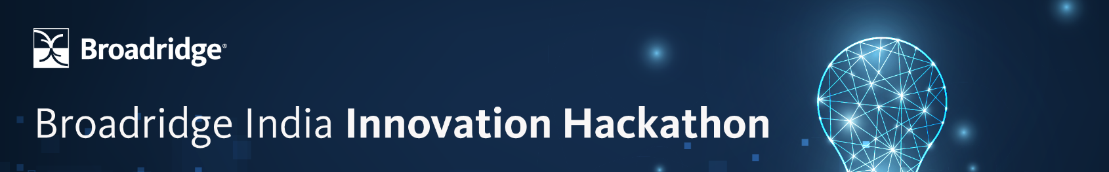
Hackathon Idea Submission Template

Slide 2
👨‍👦‍👦 Team name and member details
Team Name:
Member 1: ROHIT SAH
Member 2: SOUMYA BEHURA
📝 Theme Name: Printer-ready PDF files

Slide 3
🚩 Problem statement
We’ve to create a solution that checks the printer readiness of a PDF file before it is shared. The solution should be able to check for common printer readiness issues, such as margins, page orientation, page size, and font errors. Additionally, the solution should be able to provide feedback on how to correct any issues that are detected, such as resizing the document or adjusting margins. Overall, the solution should improve the accuracy and efficiency of printing PDF files, leading to reduced costs and time savings for individuals and organizations.

Slide 4
💡 Solution
The application will have a feature that would read all the pages of the PDF and would perform the necessary validations and provide feedbacks on any detected issues . It would check the page size and orientation of each size in the PDF file and would compare them to the standard printer paper sizes and the desired orientation by PDF parsing .If any issues are found , it would provide feedback on how to adjust the page size or orientation . It would verify the margins of each page to ensure that important content is not cut off during printing. Another important feature will be included where many templates would be available to make the pdf file look more attractive and organised for those who want to make their print look unique. The application would validate any images or graphics in the PDF file to ensure they are of sufficient resolution for printing. Low-resolution images may appear blurry when printed. To improve the efficiency, we would integrate our application into existing workflows or applications where PDF files are shared or processed. This could be through an API, a command-line tool, or a graphical user interface. Automation can help individuals and organizations quickly identify and address printer readiness issues before sharing the PDF files. It would verify the color space used in the PDF file. Some printers may have limitations on certain color spaces, leading to unexpected color outputs. This could be through an API, a command-line tool, or a graphical user interface (GUI). If an unsupported color space is detected, it would convert the document to a compatible color space.

Slide 5
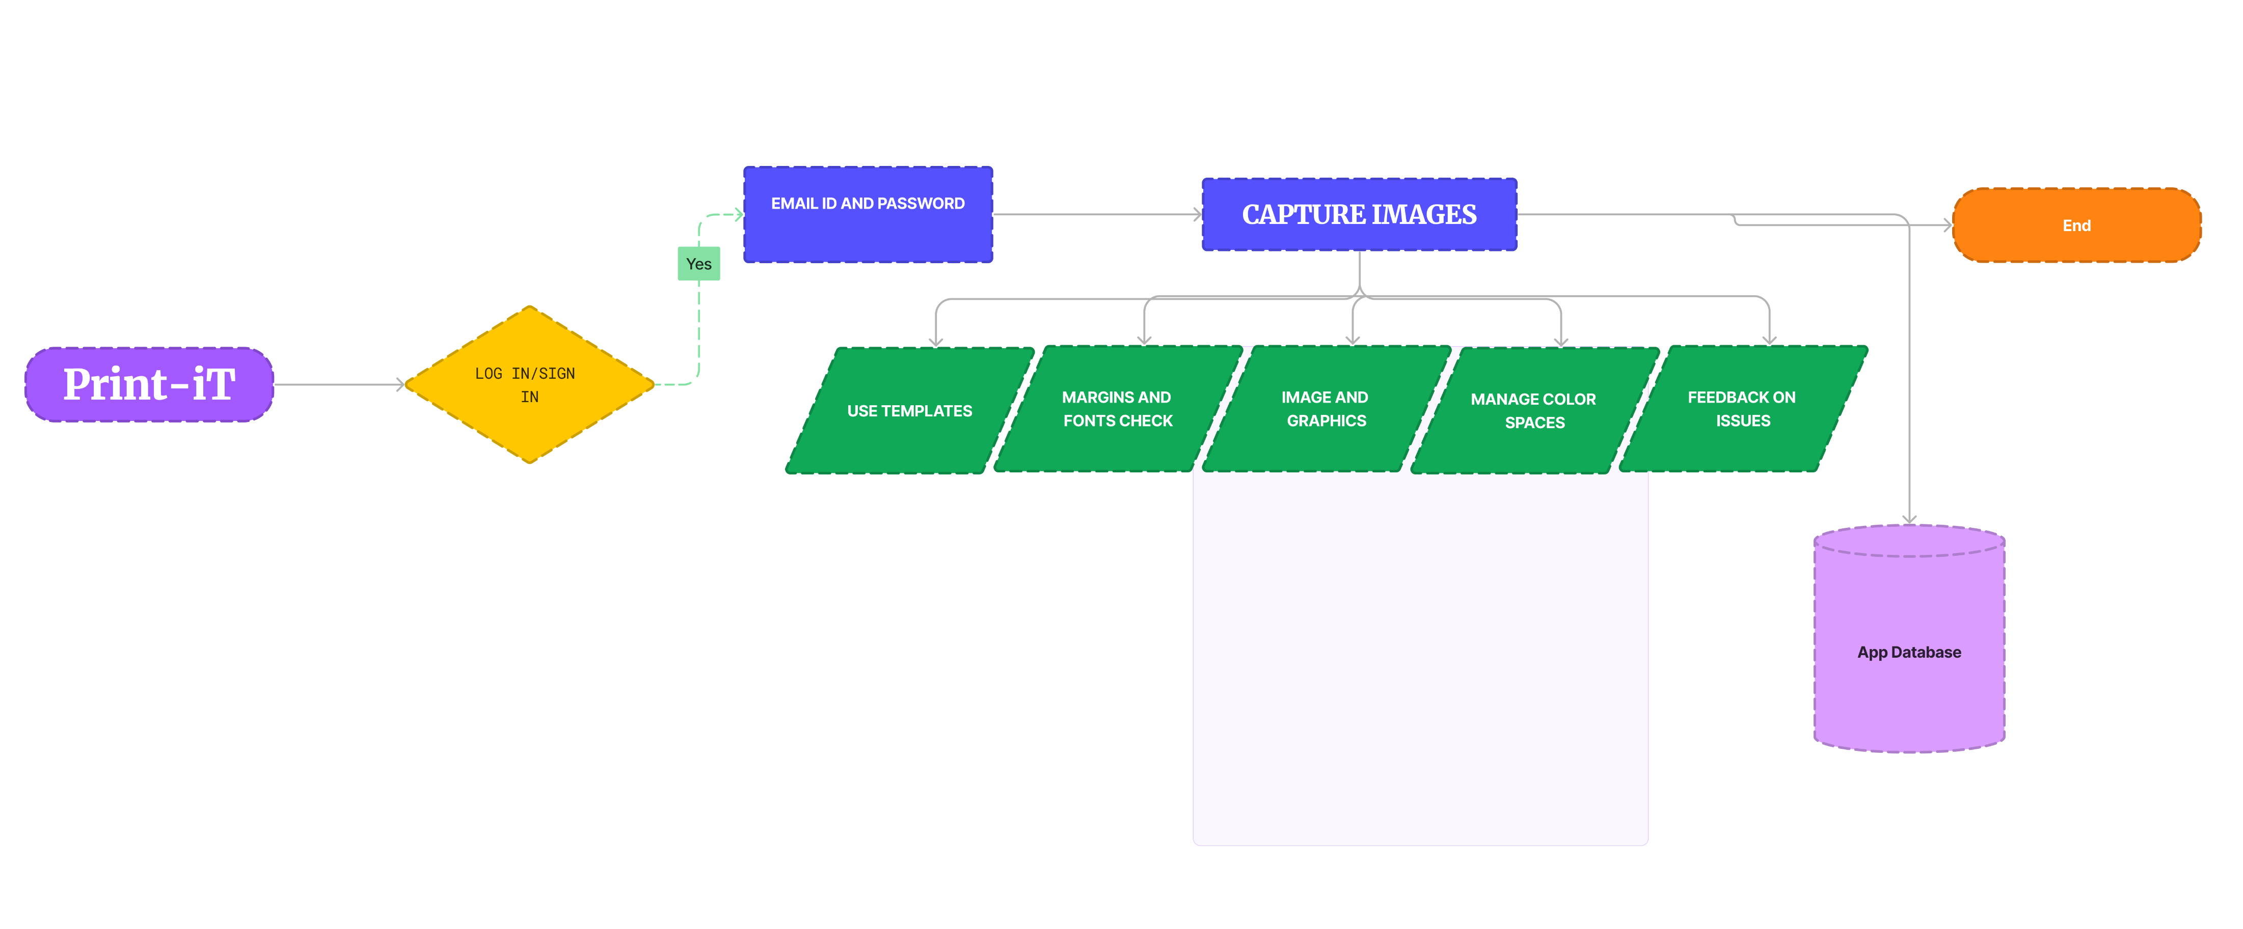
📊 Methodology / Architecture diagram

Slide 6
🚀 Future Scope
Print-ready applications play a vital role in designing product packaging and labeling. With the rise of e-commerce, there is an increased demand for eye-catching packaging that not only protects the product but also enhances the brand's identity
Business Stationery: Despite digital communication, businesses still rely on physical stationery items like business cards, letterheads, and envelopes for networking and official correspondence. Future print-ready applications can offer innovative designs, materials, and customization options, allowing businesses to create unique and memorable stationery that aligns with their brand image.
Once the solution is adopted, what impact would it create?
Data Visualization: Print-ready applications can be utilized to transform complex data into visually appealing charts, graphs, and infographics. These visual representations help businesses communicate information effectively in presentations, reports, and meetings.
Print-ready applications have a future scope in marketing collateral, packaging, business stationery, direct mail, event marketing, and data visualization

Slide 7
🎯 Impact / Novelty
Tangible and Physical Experience: Print materials offer a tangible and physical experience that digital media cannot replicate.
Enhanced Brand Perception: High-quality print materials reflect the professionalism and attention to detail of a business. Well-designed brochures, catalogs, and packaging contribute to a positive brand perception, helping businesses stand out from their competitors.
Targeted Marketing: Print materials can be strategically distributed to specific target audiences, allowing businesses to reach customers who may not be easily accessible through digital channels.
Emotional Connection and Memorability: Print materials have the ability to evoke emotions and leave a lasting impression on recipients.
Standalone Value: Print materials have inherent value beyond the digital realm. They can be displayed, shared, collected, and serve as physical reminders of a brand, event, or message.

Slide 8
Thank You

